Slide 1
NLP based Question & Answers for E-commerce Group 4
Team Members :
Ashish
John
Megha
Akshay
Swathi
Mentors:
Mr. Karthik
Mr. Parth
04/05/2020

Slide 2
Business Problem
NLP based Question & Answers for E-commerce
Objective:
An e-commerce company wants to build an algorithm to retrieve top 5
Question and answers based on the user given Keyword.

Slide 3
Project Architecture / Project Flow
1. Understanding business objective
2. Getting data set details
3. JSON to CSV
4. EDA: Exploratory Data Analysis
5. Model Building
6. Evaluate the model
7. Data Visualizations
8. Deployment Frame

Slide 4

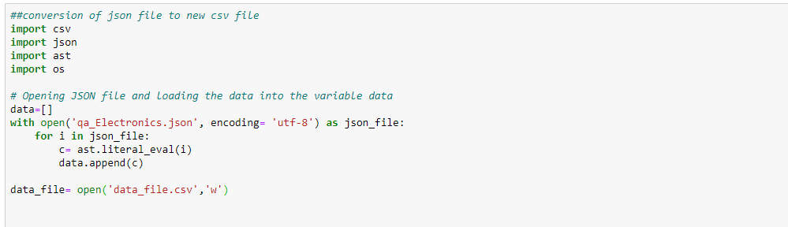
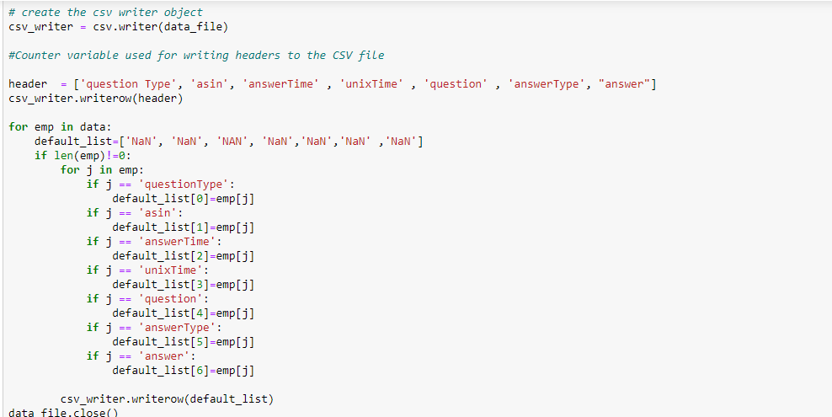
Json to csv conversion

Slide 5
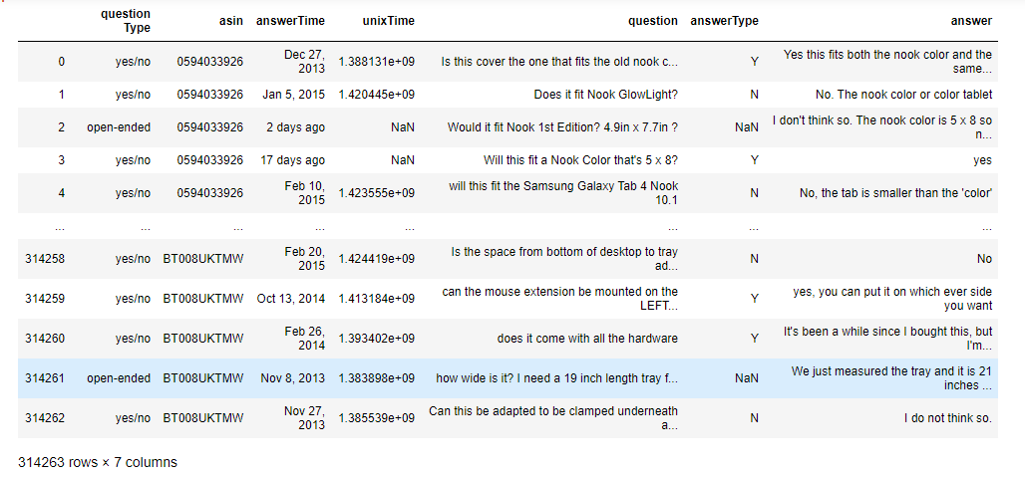
Data set details
The dataset is given in json format, prerequisite is to change json data to data frame
The dataset contains question, answer, question type, asin ID, answer time and Unix time
The dimension of the data set is 314263 (observations) , 7(number of columns)
There are 32 missing values are observed in question and answer column
Below is the sample Display of 10 rows and all the columns of the data from the dataset

Slide 6
Exploratory Data Analysis (EDA) and Feature Engineering

Slide 7
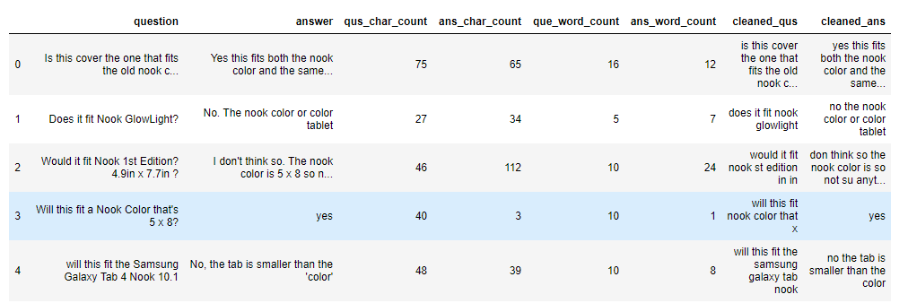
Exploratory Data Analysis (EDA)
Basic Text Processing & Deep processing.
Question’s & Answer’s character count and it’s word count.
Removing stop words and whitespaces.
Removing the puncutations, special characters and numbers. all upper case to lower case.
Tokenization where sentence is tokenize into words.
Lemmatization grouping together the different infected form of words.

Slide 8
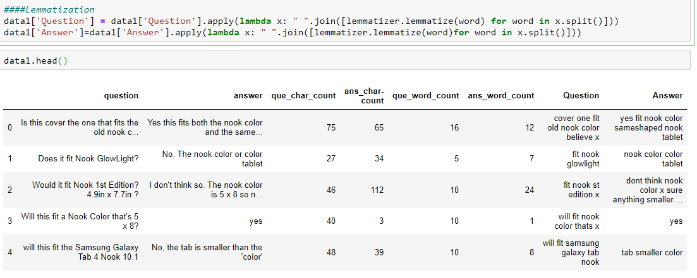
Data Cleaning for Question and Answer

Slide 9
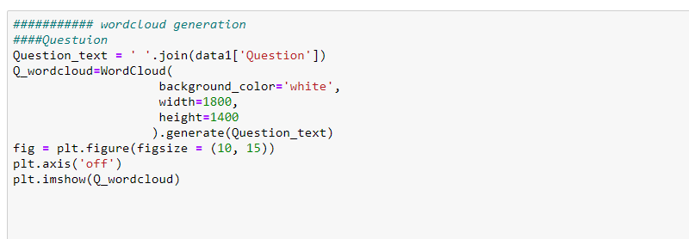
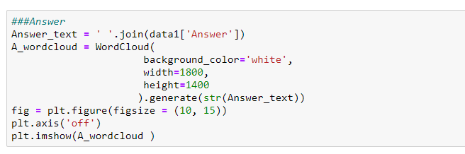
Word Cloud for Question and Answer

Slide 10
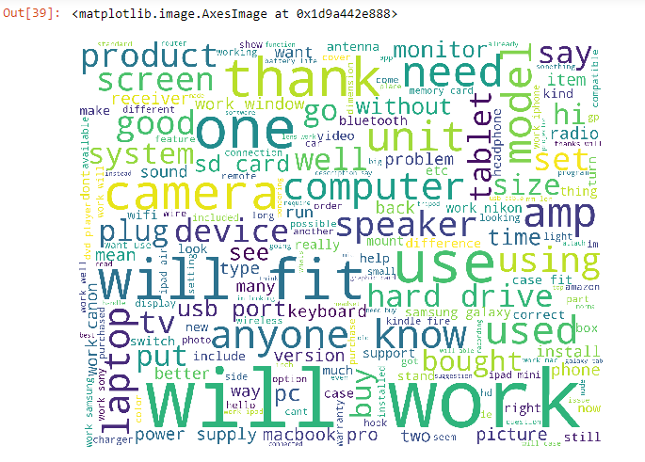
Word Cloud of Question & Answer
Question :

Slide 11
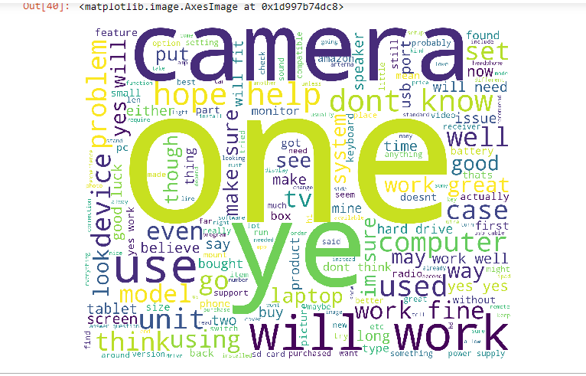
Word Cloud of Question & Answer
Answer :
:

Slide 12
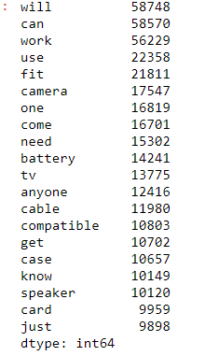
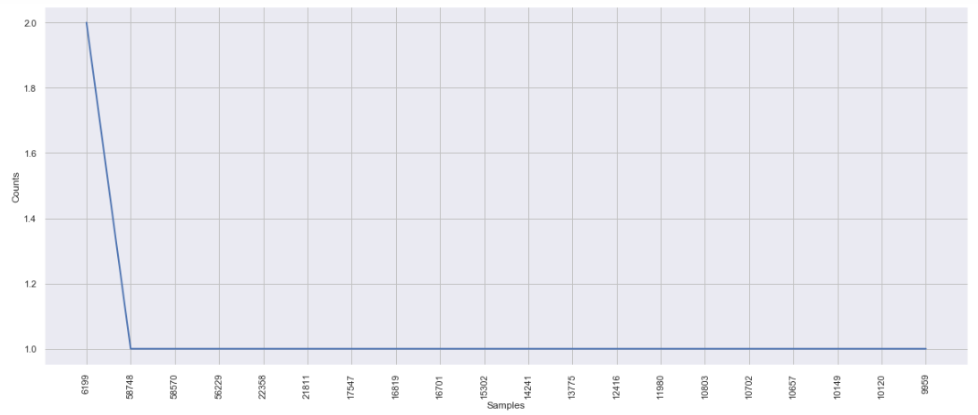
Top20 frequently used words in Question & Answer

Slide 13
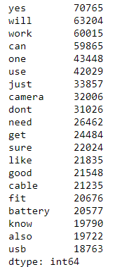
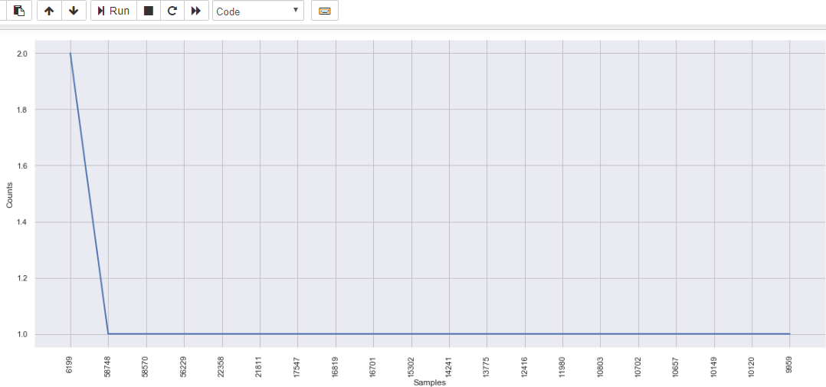
Top 20 Frequently used Answers

Slide 14
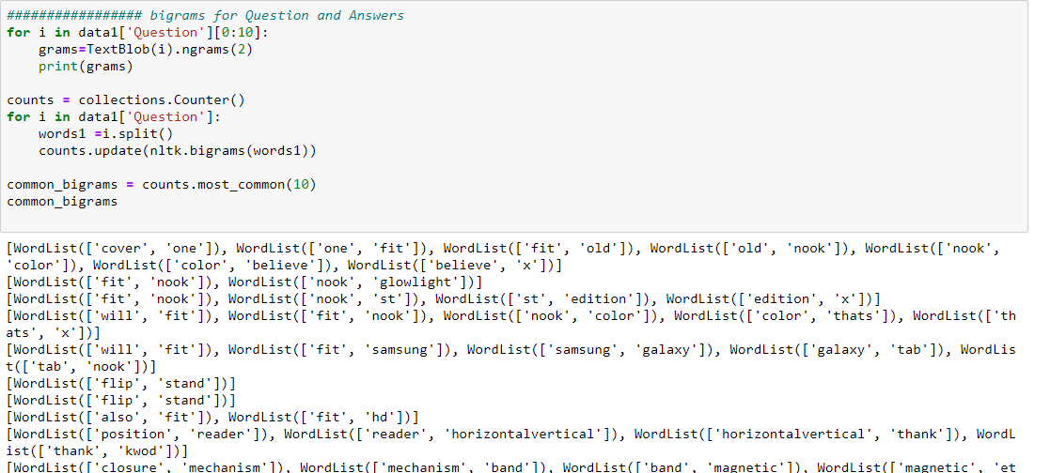
Bigrams

Slide 15
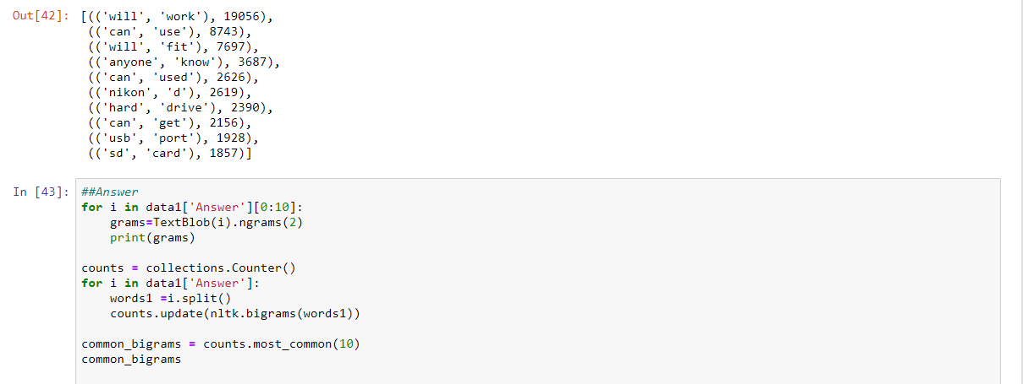
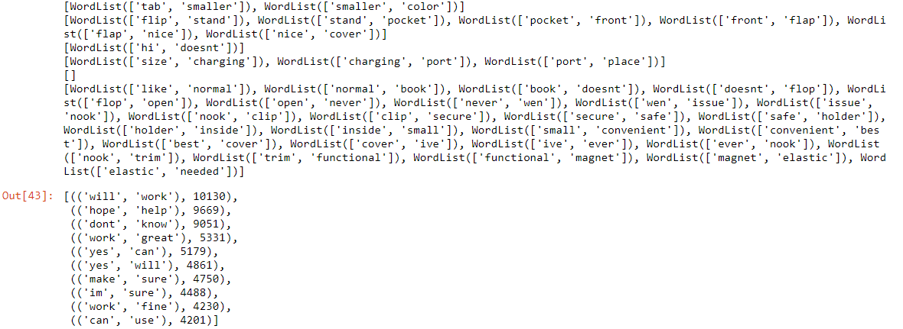

Slide 16
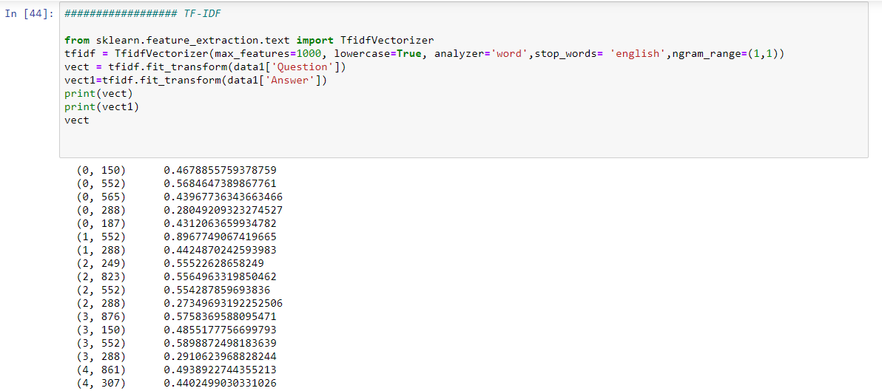
TD-IDF Vectorizer

Slide 17
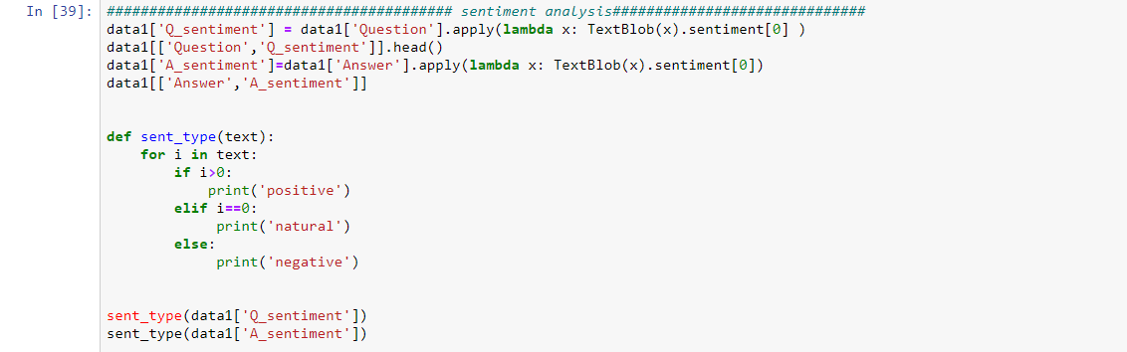
Question and Answer Sentiment

Slide 18
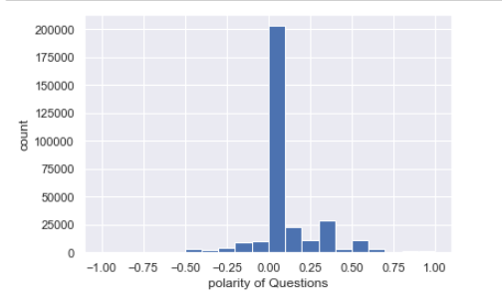
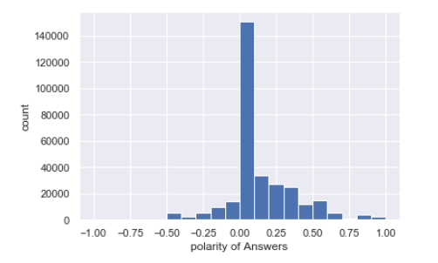
Sentimental Analysis of Question & Answer

Slide 19
Model Building

Slide 20
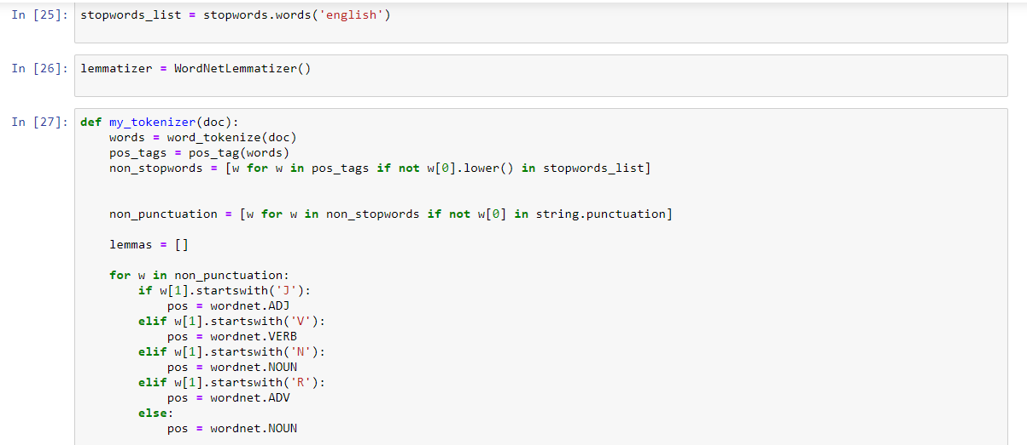
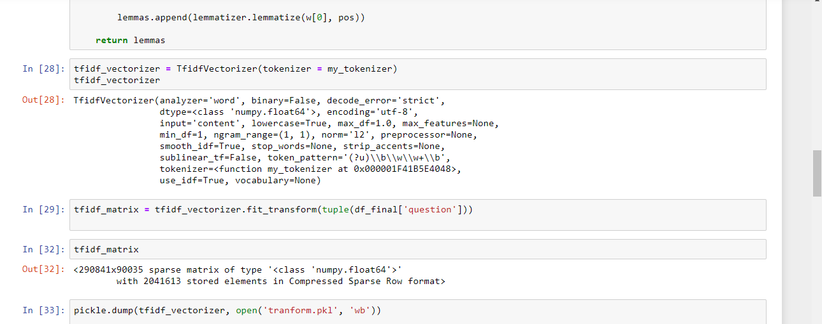
Model Building

Slide 21
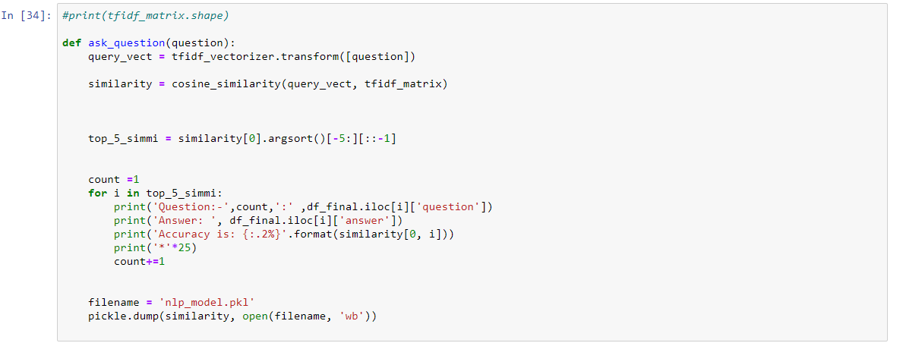
Model Evaluating

Slide 22
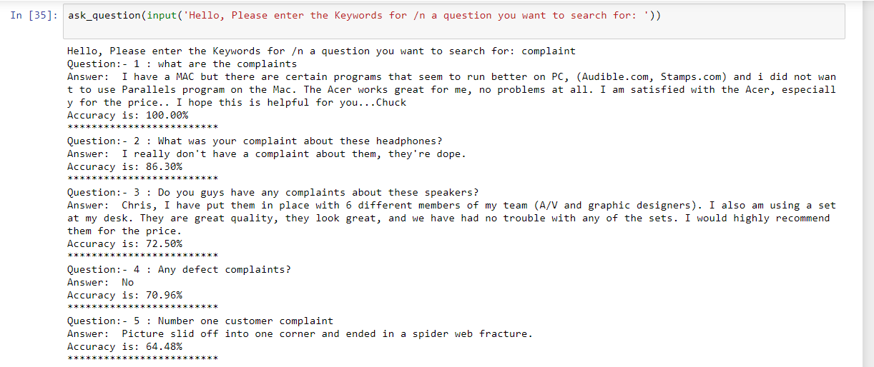
Model Prediction and Results
Model generated the output of top 5 Question and Answer with respect to the keyword entered.

Slide 23
Model Deployment using Flask
We used the Heroku platform since its one of the easiest to use for deployment.
Before we use Heroku, we need to install some command line tools and create our application.

Slide 24
Steps to Create Our Application on Local Machine
Create Flask App
Install gunicorn
Create a requirements.txt file
Create a Profile
Create a Heroku Account
Push and launch the application

Slide 25
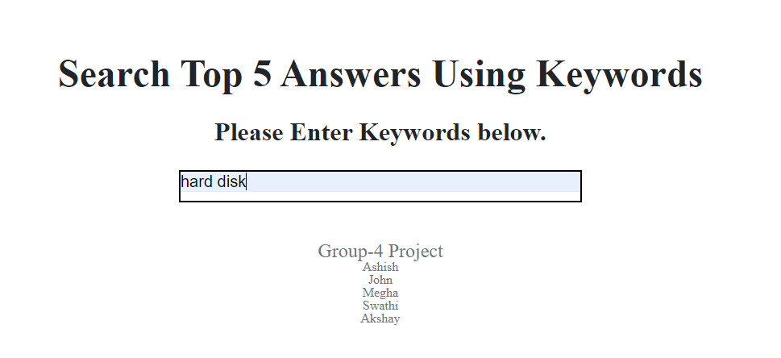
Home Template

Slide 26
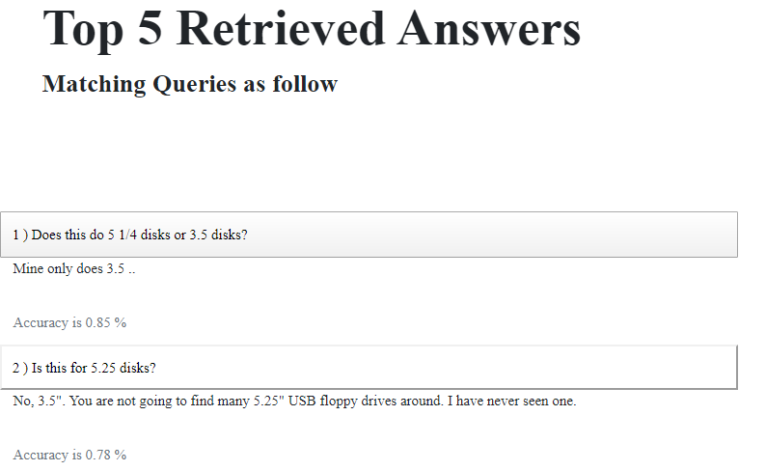
Results Template

Slide 27
Project Link
https://top5-qa-search.herokuapp.com/

Slide 28
Challenges faced?
Memory Error
HTML and CSS
How did you overcome?
Google Colab
Reference from Github and Modifications Using Bootstrap

Slide 29
Thank you

